Slide 1
Intro to Supercomputing
Xiao Zhu
Senior Research Scientist
Research Computing, ITaP
ME 614
Feb. 8th, 2017

Slide 2
Homework 0.2
Learn to set up MPI computing environment.
module load intel
module load impi
module list
Compile and run a MPI code.
1. copy either the C or Fortran code to your own account from /scratch/scholar/z/zhu472/me614
2. Compile the code
mpiicc helloworld.c –o helloworld
mpiifort helloworld.F90 –o hellworld
3. Do a quick run
mpirun –np 4 ./helloword
Notes:
.If the communicator is MPI_COMM_WORLD, then it represents the number of MPI tasks available to your application.

Slide 3
Login nodes vs Compute nodes

Slide 4

JOBS
WHERE NOT TO RUN A JOB
Remember, cluster front-end nodes are shared resources for
Creating, submitting, and monitoring jobs
File transfers
Preparing inputs
Editing and compiling code
Small-scale testing
May be used by 50+ people simultaneously
Check out the who command
Jobs should have no interference by other people
Want jobs carefully arranged on compute nodes
https://en.wikipedia.org/wiki/Rapid_transit#/media/File:Moscow_MetroCrowded_(pixinn.net).jpg
Notes:
Example who

Slide 5

JOBS SUBMISSION
WHERE TO RUN A JOB
Jobs are submitted to the cluster
Cluster executes jobs on back-end compute nodes
Jobs are carefully scheduled and arranged on the compute nodes
https://en.wikipedia.org/wiki/SNCF_TGV_Duplex#/media/File:TGV_Dupex_First_Class.jpg

Slide 6
JOB SUBMISSION SCRIPT
Commands that instructs cluster precisely what to do to complete your work
Self contained to be executed without any interaction
Jobs need to specify the resources they require
Three basic units:
Number of nodes
Number of cores
Time
Memory
Other resources
Cluster will allocate requested resources once they are available
Job starts once resources are allocated
Notes:
Add something for others

Slide 7
EXAMPLE JOB SUBMISSION SCRIPT
subjob.sub
#!/bin/sh -l
#PBS -N mpi_job
#PBS -q scholar
#PBS -l nodes=1:ppn=20
#PBS -l walltime=03:00:00
module purge
module load intel
module load impi
module list
cd $PBS_O_WORKDIR
pwd
date +"%d %B %Y %H:%M:%S"
# An MPI job
mpirun -np 16./a.out
echo " "
date +"%d %B %Y %H:%M:%S"
Notes:
Two columns

Slide 8
COMPONENTS OF A SUBMISSION SCRIPT
PBS directives
Specify resources needed such as number of nodes, cores
Module load
Set up paths, libraries
PBS environment variables
Set by PBS, can be used in your submission script
Customized commands
Your job to run

Slide 9
PBS DIRECTIVE
A way to set PBS job attributes
Appear at the top of your submission file
Common PBS job attributes include:
PBS directives | Description
#PBS -l nodes=2:ppn=20 | Number of nodes and cores required
#PBS –q scholar | The destination queue of the job
#PBS –N test | The name of the job
#PBS –l walltime=00:10:00 | The estimated maximum walltime of the job, the job will be killed beyond this walltime

Slide 10
EXAMPLE JOB SUBMISSION SCRIPT
subjob.sub
#!/bin/sh -l
#PBS -N mpi_job
#PBS -q scholar
#PBS -l nodes=4:ppn=20
#PBS -l walltime=72:00:00
module purge
module load intel
module load impi
module list
cd $PBS_O_WORKDIR
pwd
# An multi-node MPI job
mpirun –np $PBS_NP
-machinefile $PBS_NODEFILE
./a.out
$PBS_NP: number of execution slots (cores) for the job
$PBS_NODEFILE: a list of nodes requested
$PBS_O_WORKDIR: job submission directory
$PBS_JOBID: unique PBS job id
Notes:
Two columns

Slide 11
HOW TO SUBMIT AND MONITOR YOUR JOB
qsub
Once you have a job submission script, you may submit this script to PBS using the qsub command. PBS will find an available compute node or set of compute nodes and run your job there, or leave your job in a queue until some become available.
$ qsub subjob.sub 787233.rice-adm.rcac.purdue.edu # here the number indicates the job id that PBS # assigns to the job, this number can be used to track # your job.

Slide 12
HOW TO MONITOR THE STATUS OF YOUR JOB
qstat –u myusername
List all current jobs from the user myusername, where myusername is your Purdue login.
$ qstat -u zhu472 rice-adm.rcac.purdue.edu:
 |  |  |  |  |  |  |  | Req'd | Req'd |  | Elap
 | Job ID | Username | Queue | Jobname | SessID | NDS | TSK | Memory | Time | S | Time
 | ----------- | -------- | ----- | ------- | ------ | --- | --- | ------ | ------ | - | -----
 | 787233.rice-adm.rcac. | zhu472 | scholar | mpi_job | -- | 1 | 20 | -- | 03:00:00 | Q | --

Slide 13
HOW TO SUBMIT AND MONITOR YOUR JOB
qdel
Stop and delete the job ID myjobid
$ qstat -u zhu472
 | rice-adm.rcac.purdue.edu:
 | Job ID | Username | Queue | Jobname | SessID | NDS | TSK | Memory | Time | S | Time
 | --------------------- | --------- | -------- | --------- | ----- | --- | ---- | ------ | ------ | - | -------
 | 787233.rice-adm.rcac. | zhu472 | scholar | mpi_job | 12208 | 1 | 20 | -- | 3:00:00 | R | 01:00:11
$ qdel 787233 $ qstat -u zhu472
 | rice-adm.rcac.purdue.edu:
 |  |  |  |  |  |  |  | Req'd | Req'd |  | Elap
 | Job ID | Username | Queue | Jobname | SessID | NDS | TSK | Memory | Time | S | Time
 | -------------------- | --------- | -------- | --------- | ----- | --- | ---- | ------ | ------ | - | -------
 | 787233.rice-adm.rcac. | zhu472 | scholar | mpi_job | 12208 | 1 | 20 | -- | 3:00:00 | C | --
Notes:
Fix the commands
complete
when a job completes can remind in the C status for ~10seconds
If you delete the job and if PBS cannot talk to the node your job may not stop for a while, so WAIT! Don’t sent a ticket right a way

Slide 14
HOW TO CHECK FOR AVAILABLE RESOURCES
qlist
List all queues I can use and their current status and limits.
$ qlist Current Number of Cores
 | Queue | Total | Queue | Run | Free | Max Walltime
 | ================= | ==================================== |  |  |  | ===============
 | scholar | 320 | 20 | 100 | 220 | 168:00:00
 | standby | 10,260 | 17,168 | 4,390 | 627 | 4:00:00
Notes:
Change to $ instead 10,260 17,168 4,390 627

Slide 15
Overview of MPI
Message Passing Interface
Many implementations, interfaces in C/Fortran
Distributed memory model, but also work on shared memory / hybrid architecture
An MPI program is launched as separate processes (tasks)
Requiring data/task partitioning across tasks; if not, every task run the same thing
Data is explicitly moved from task to task ( message passing)
Point-to-point
Collective

Slide 16
Type of Communications
Point-to-Point
Collective
Notes:
.If the communicator is MPI_COMM_WORLD, then it represents the number of MPI tasks available to your application.

Slide 17
Point-to-Point Communication
Involve message passing between two different MPI processes/tasks.
One task performs a send operation and the other task performs a matching receive operation.
There should be a matching receive routine for every send routine.
If a send is not paired with a matching receive then the code will have a deadlock.
http://www.mcs.anl.gov/research/projects/mpi/sendmode.html
Notes:
.If the communicator is MPI_COMM_WORLD, then it represents the number of MPI tasks available to your application.

Slide 18
Synchronous vs Asynchronous
Synchronous
Call does not return until the message is sent or received
Asynchronous
Call indicates a start of send or receive, and another call is made to determine if communication is finished.
http://www.mcs.anl.gov/research/projects/mpi/sendmode.html
Notes:
.If the communicator is MPI_COMM_WORLD, then it represents the number of MPI tasks available to your application.

Slide 19
Point-to-Point Communication
Notes:
.If the communicator is MPI_COMM_WORLD, then it represents the number of MPI tasks available to your application.

Slide 20
Point-to-Point Communication
http://www.mcs.anl.gov/research/projects/mpi/sendmode.html
Notes:
.If the communicator is MPI_COMM_WORLD, then it represents the number of MPI tasks available to your application.

Slide 21
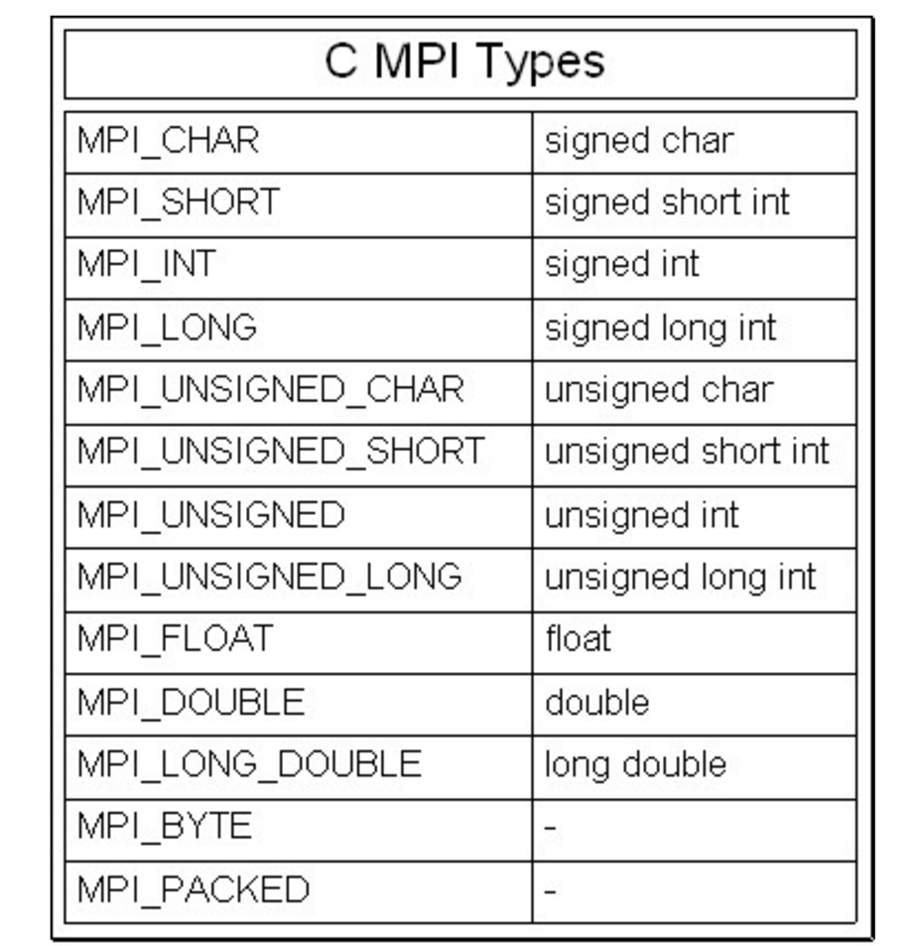
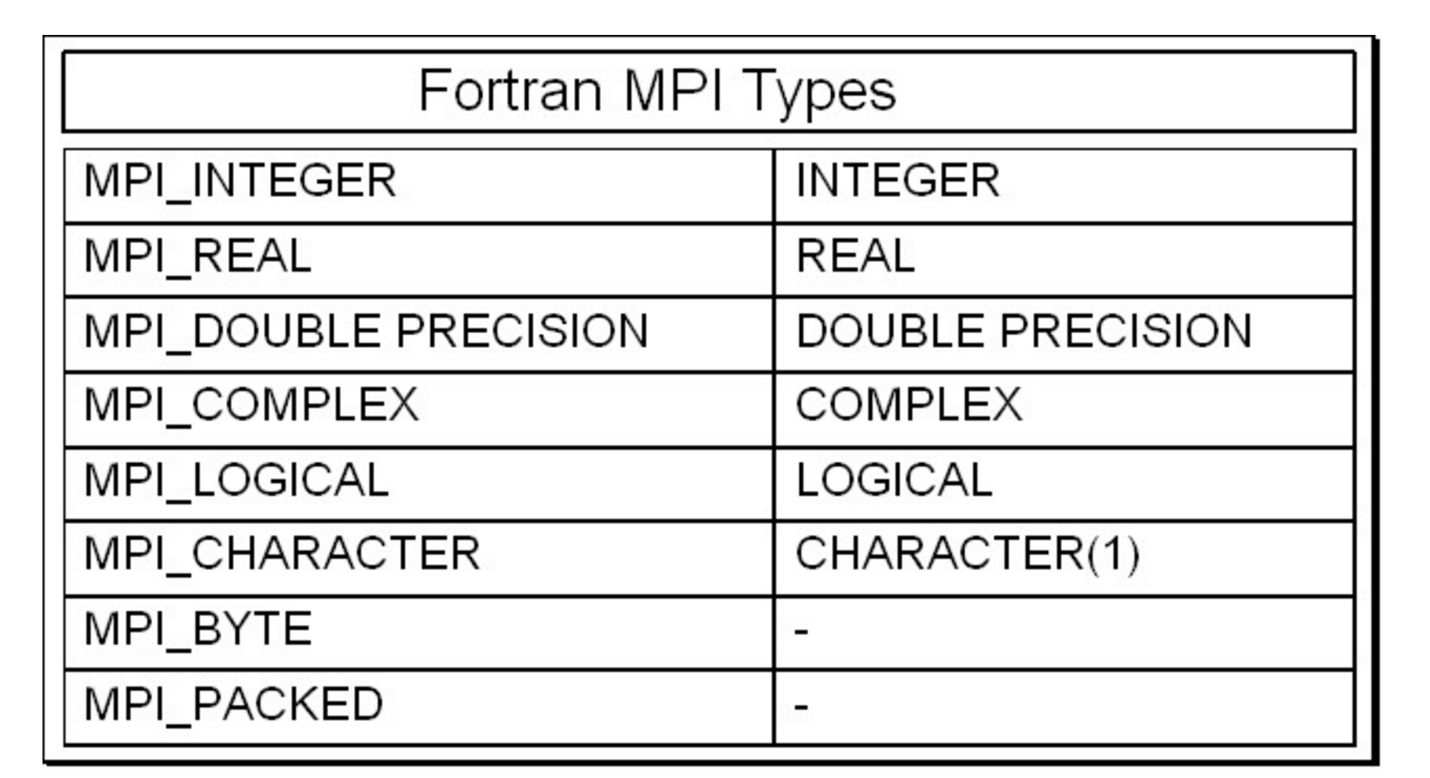
Data Type
When sending a message, it is given a data type;
MPI has many predefined types correspond to “normal” types;
Can create user-defined types.

Slide 22
Point-to-Point Communication
// Find out rank, size
int rank, size;
MPI_Comm_rank(MPI_COMM_WORLD, &rank);
MPI_Comm_size(MPI_COMM_WORLD, &size);
int number;
if (rank == 0) {
number = -1;
MPI_Send(&number, 1, MPI_INT, 1, 0, MPI_COMM_WORLD);
} else if (rank == 1) {
MPI_Recv(&number, 1, MPI_INT, 0, 0, MPI_COMM_WORLD,
MPI_STATUS_IGNORE);
printf(”Task 1 recv number %d from task 0\n", number);
}
Notes:
.If the communicator is MPI_COMM_WORLD, then it represents the number of MPI tasks available to your application.

Slide 23
Point-to-Point Communication
if (rank == 0) {
dest = 1;
source = 1;
MPI_Send (&outmsg,1,MPI_CHAR,dest,tag, MPI_COMM_WORLD);
MPI_Recv (&inmsg,1,MPI_CHAR,source,tag, MPI_COMM_WORLD,&Status);
} else if (rank == 1){
dest = 0;
source = 0;
MPI_Send (&outmsg,1,MPI_CHAR,dest,tag, MPI_COMM_WORLD);
MPI_Recv (&inmsg,1,MPI_CHAR,source,tag, MPI_COMM_WORLD,&Status);
}
Is the code going to run?
Notes:
.If the communicator is MPI_COMM_WORLD, then it represents the number of MPI tasks available to your application.

Slide 24
Collective Communications
Defined as communication between > 2 processes
One-to-many, many-to-one, many-to-many
All processes within the communicator call the same collective communication function with matching argument.

Slide 25
Collective Communications
Synchronization (Barrier)
Data Movement (Broadcast, Scatter, Gather, etc)
Collective Computation (Reduce, Allreduce)

Slide 26
Synchronization
MPI_Barrier creates a barrier synchronization in a group.
Each task, when reaching the MPI_Barrier call, blocks until all tasks in the group reach the same MPI_Barrier call
MPI_Barrier (comm)
NO data exchange
26

Slide 27
DATA MOVEMENT
27

Slide 28
Collective Computation
MPI_Reduce applies a reduction operation on all tasks in a group and places the result in one task(root).
MPI_Reduce ( &sendbuf, &recvbuf, count, datatype, mpi_red_op, root, comm)
MPI_Allreduce applies a reduction operation on all tasks in a group and passes the result to all tasks.
MPI_Allreduce ( &sendbuf, &recvbuf, count, datatype, mpi_red_op, comm)
Often used mpi_red_op includes: MPI_MAX, MPI_MIN, MPI_SUM, MPI_PROD. User can also define own reduce operation.
28

Slide 29
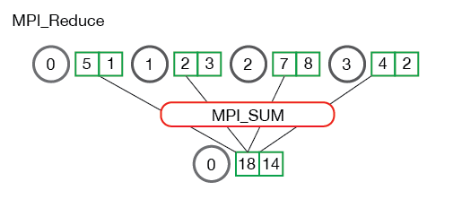
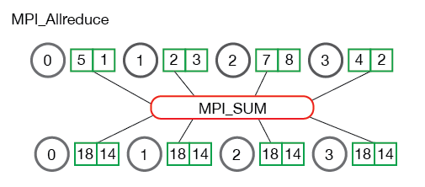
Collective Computation
29

Slide 30
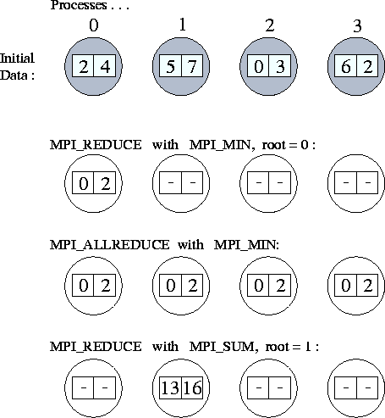
Collective Computation
30

Slide 31
One more example – for loop
#include <stdio.h>
int main(int argc,char *argv[]){
int i, sum, upToVal;
upToVal = 10000;
sum=0;
for(i=1; i<= upToVal; i++){
sum = sum +i;
}
printf("\nSum is %d\n", sum);
return 0;
}
31

Slide 32
One more example – for loop
#include <stdio.h>
#include <mpi.h>
int main(int argc,char *argv[]){
int i, sum, upToVal;
upToVal = 10000;
sum=0;
int totalTasks, myRank;
MPI_Init( &argc, &argv );
MPI_Comm_size( MPI_COMM_WORLD, &totalTasks );
MPI_Comm_rank( MPI_COMM_WORLD, &myRank );
for(i=1; i<= upToVal; i++){
sum = sum +i;
}
printf("\nSum is %d\n", sum);
MPI_Finalize();
return 0;
}
32

Slide 33
One more example – for loop
Task 0
Task 1
Task 2
Task 3
start end
start end
start end
start end
partial_sum
partial_sum
partial_sum
partial_sum
int start, end;
start = myRank*(upToVal/totalTasks) + 1
if (myRank == 0){end = upToVal}
else {end = start + upToVal/totalTasks - 1}
for(i=start; i<= end; i++){
partial_sum = partial_sum +i;
}
33

Slide 34
One more example – for loop
Task 0
Task 1
Task 2
Task 3
start end
start end
start end
start end
partial_sum
partial_sum
partial_sum
partial_sum
sum
Task 0
Task 1 to totalTasks - 1 send partial_sum to task 0
Tasks 0 receives partial_sum from task 1 to totalTasks - 1
34

Slide 35
One more example – for loop
if ( myRank == 0 ){
sum=partial_sum;
for (i=1;i<totalTasks;i++) {
MPI_Recv( &partial_sum, 1 , MPI_INT, i ,0, MPI_COMM_WORLD, MPI_STATUS_IGNORE);
sum+=partial_sum;
}
printf("\nSum is %d\n", sum);
}
else{
MPI_Send( &partial_sum, 1 , MPI_INT, 0, 0, MPI_COMM_WORLD);
}
35

Slide 36
One more example – for loop
if ( myRank == 0 ){
sum=partial_sum;
for (i=1;i<totalTasks;i++) {
MPI_Recv( &partial_sum, 1 , MPI_INT, i ,0, MPI_COMM_WORLD, MPI_STATUS_IGNORE);
sum+=partial_sum;
}
printf("\nSum is %d\n", sum);
}
else{
MPI_Send( &partial_sum, 1 , MPI_INT, 0, 0, MPI_COMM_WORLD);
}
36

Slide 37
One more example – for loop
if ( myRank == 0 ){
sum=partial_sum;
for (i=1;i<totalTasks;i++) {
MPI_Recv( &partial_sum, 1 , MPI_INT, MPI_ANY_SOURCE ,0, MPI_COMM_WORLD, MPI_STATUS_IGNORE);
sum+=partial_sum;
}
printf("\nSum is %d\n", sum);
}
else{
MPI_Send( &partial_sum, 1 , MPI_INT, 0, 0, MPI_COMM_WORLD);
}
37

Slide 38
One more example – for loop
Task 0
Task 1
Task 2
Task 3
start end
start end
start end
start end
partial_sum
partial_sum
partial_sum
partial_sum
sum
Task 0
Task 1 to totalTasks - 1 send partial_sum to task 0
Tasks 0 receives partial_sum from task 1 to totalTasks - 1
38

Slide 39
Documentation
Parallel Computing Books
http://pages.tacc.utexas.edu/~eijkhout/istc/istc.html
MPI Standard
http://www.mcs.anl.gov/research/projects/mpi/
http://mpi-forum.org/
MPI Books:
http://mpitutorial.com/recommended-books/
http://www.netlib.org/utk/papers/mpi-book/mpi-book.html
MPI Tutorials:
http://mpitutorial.com/tutorials/
https://computing.llnl.gov/tutorials/mpi/
OpenMP specification:
http://www.openmp.org/
OpenMP Tutorials:
https://computing.llnl.gov/tutorials/openMP/

Slide 40
mpi4py
One implementation of MPI in Python.
MPI4Py proves an interface very similar to the MPI standard.
Why Python?
Easy
Prototyping
What you lose in performance, you gain in shorter development time.
Can be used for production if the communication is NOT very frequent and performance is NOT the primary concern.

Slide 41
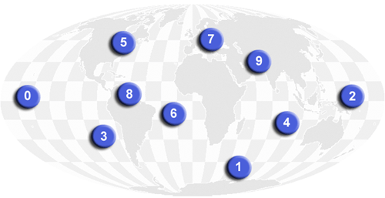
Communicators
from mpi4py import MPI
comm = MPI.COMM_WORLD
rank = comm.Get_rank()
size = comm.Get_size()
Or
rank = comm.rank
size = comm.size
Communicators are objects that are used to define which collection of processes may communicate with each other.
Predefined Instances:
COMM_WORLD: all the process involved (MPI_COMM_WORLD)
COMM_SELF: contains just the calling process itself
COMM_NULL: no communicator

Slide 42
First mpi4py code hello.py
from mpi4py import MPI
comm = MPI.COMM_WORLD
rank = comm.Get_rank()
size = comm.Get_size()
print "hello world from rank %2d out of %2d processors" % (rank,size)
No need to call MPI_Init() or MPI_Finalize()
To launch
$ module load intel
$ module load python
$ mpirun –np 4 python ./hello.py

Slide 43
Point to Point Communication
Python objects can be communicated with send and receive methods of the communicator.
send(data, dest, tag)
data: Python object to send
dest: destination rank
tag: id given to the message
data = recv(source, tag)
data is provided as return value
source: source rank
tag: id given to the message

Slide 44
Example – send/recv
from mpi4py import MPI
comm = MPI.COMM_WORLD
assert comm.size == 2
if comm.rank == 0:
sendmsg = 123
comm.send(sendmsg, dest=1, tag=11)
recvmsg = comm.recv(source=1, tag=22)
print "[%02d] Received message: %s" % (comm.rank, recvmsg)
else:
recvmsg = comm.recv(source=0, tag=11)
print "[%02d] Received message: %d" % (comm.rank, recvmsg)
sendmsg = "Message from 1"
comm.send(sendmsg, dest=0, tag=22)

Slide 45
Data Communication
General Python objects
All-lowercase methods of the Comm class, like send(), recv()
Conversion between Python objects and byte stream introduces an overhead
Slow
Buffer-provider objects (e.g., NumPy arrays, contiguous array)
Uppercase methods of the Comm class, like Send(), Recv()
Little overhead, fast
Recv(data, source, tag,status)
Data is specified by a 2/3-list/tuple such as [data, MPI.DOUBLE], or [data, count, MPI.DOUBLE]

Slide 46
Example – numpy array
from mpi4py import MPI
import numpy
comm = MPI.COMM_WORLD
assert comm.size == 2
rank = comm.rank
# pass explicit MPI datatypes
if rank == 0:
data = numpy.arange(10, dtype='i')
comm.Send([data, MPI.INT], dest=1, tag=77)
elif rank == 1:
data = numpy.empty(10, dtype='i')
comm.Recv([data, MPI.INT], source=0, tag=77)
print "[%02d] Received: %s" % (rank, data)

Slide 47
Example – numpy array
from mpi4py import MPI
import numpy
comm = MPI.COMM_WORLD
assert comm.size == 2
rank = comm.rank
# automatic MPI datatype discovery
if rank == 0:
data = numpy.arange(10, dtype=numpy.float64)
comm.Send(data, dest=1, tag=13)
elif rank == 1:
data = numpy.empty(10, dtype=numpy.float64)
comm.Recv(data, source=0, tag=13)
print "[%02d] Received: %s" % (rank, data)

Slide 48
Collective Communication
Multiple processes within the same communicator exchange messages and possibly perform operations.
Similar to p2p communications, all-lowercase and uppercase methods can be used for collective communications.
Bcast vs bcast

Slide 49
Collective Communication –bcast
from mpi4py import MPI
comm = MPI.COMM_WORLD
rank = comm.Get_rank()
if rank == 0:
data = {'key1' : [7, 2.72, 2+3j],
'key2' : ( 'abc', 'xyz')}
else:
data = None
data = comm.bcast(data, root=0)
print "[%02d] %s" % (comm.rank , data)

Slide 50
Example – Scatter
from mpi4py import MPI
import numpy
comm = MPI.COMM_WORLD
size = comm.Get_size()
rank = comm.Get_rank()
LENGTH=3
if rank == 0:
data = numpy.linspace(1,size*LENGTH,size*LENGTH)
else:
data = None
data_local = numpy.zeros(LENGTH)
comm.Scatter(data,data_local,root=0)
print "[%2d] %s" % (rank,data_local)
http://materials.jeremybejarano.com/MPIwithPython/

Slide 51
Reference
http://materials.jeremybejarano.com/MPIwithPython/

